Slide 1
LESSON 15
NEXTJS NFT Marketplace

Slide 2
Hikmah Nisya - 1103184094 Radzis Araaf Jaya Jamaludin - 1103184234 Raudhatul Rafiqah Assyahiddini - 1103180225

Slide 3
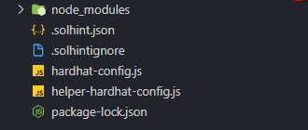
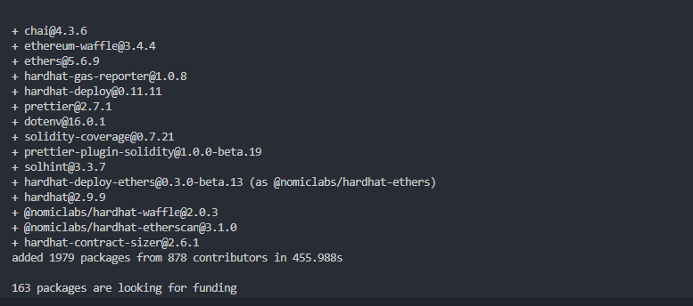
Part I: NFT Marketplace Contracts (Setup)

Slide 4

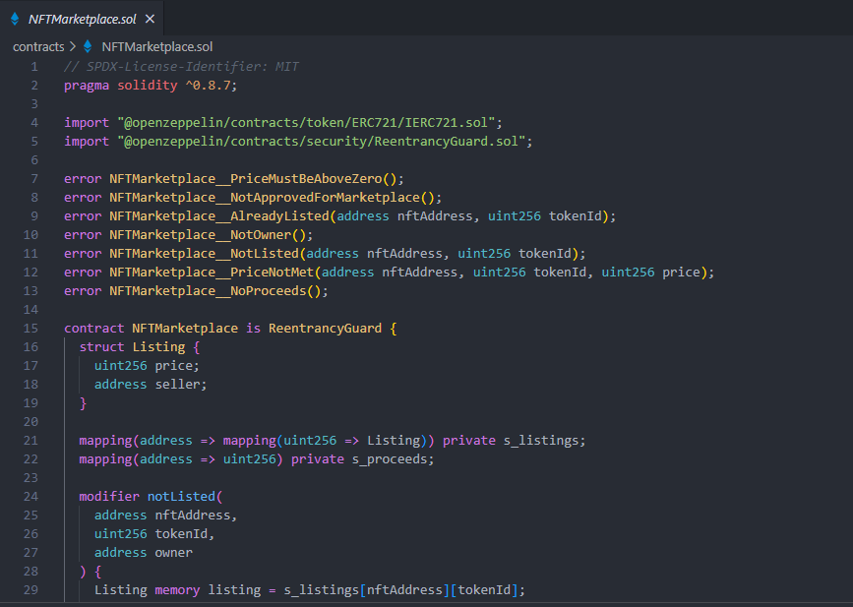
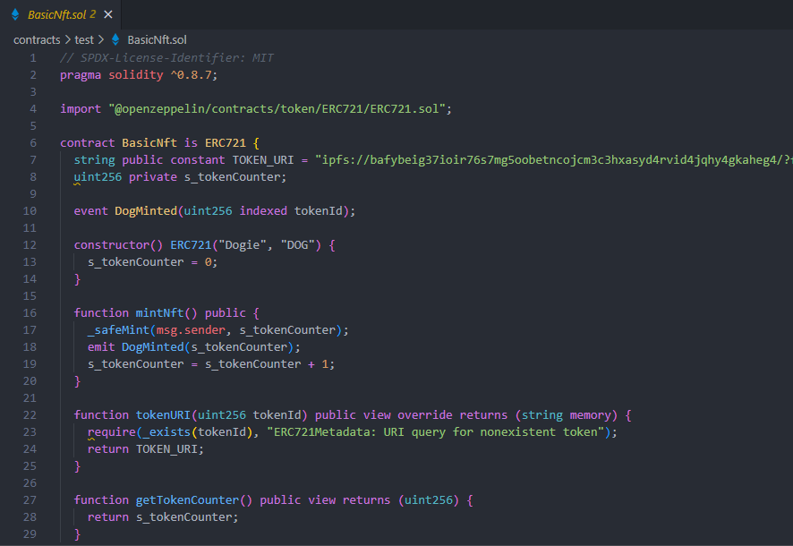
Part I: NFT Marketplace Contracts

Slide 5

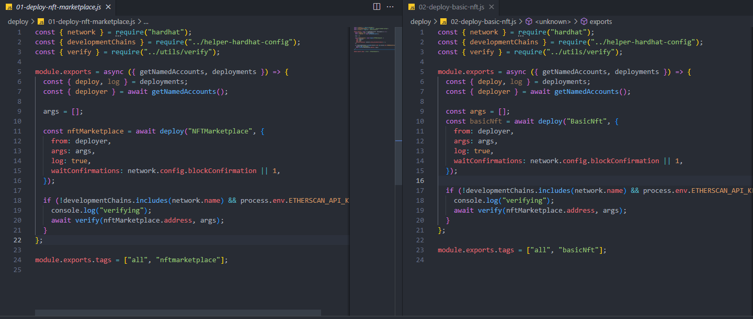
Part I: NFT Marketplace Contracts (deploy)

Slide 6
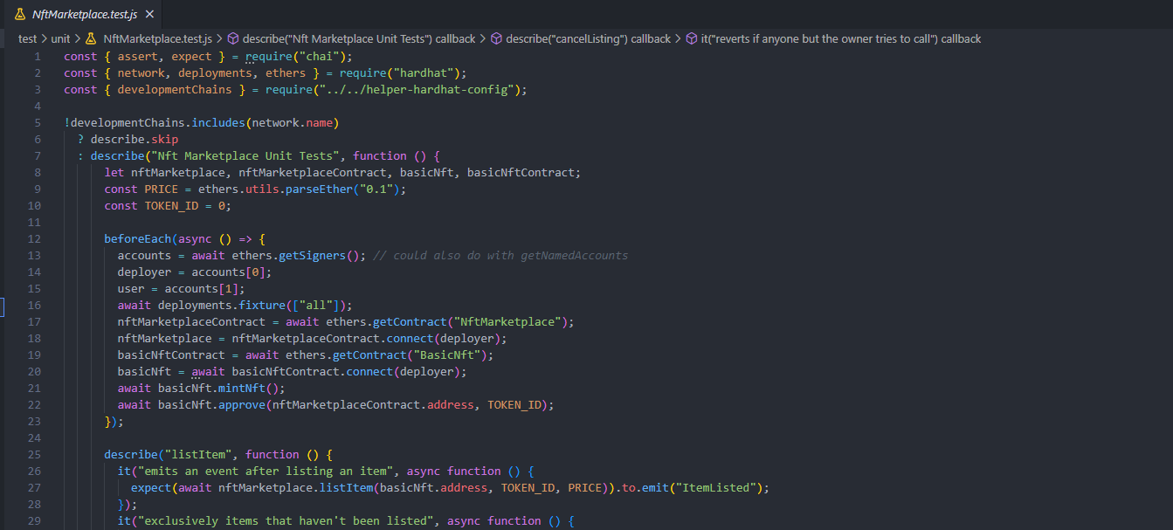
Part I: NFT Marketplace Contracts (unit test)

